Slide 1





ISCG8050 Machine Learning for Intelligent Data and Information Processing
Week 2 - B
Sources: Hands-On Machine Learning with Scikit-Learn, Keras, and TensorFlow by Aurélien Géron

Slide 2
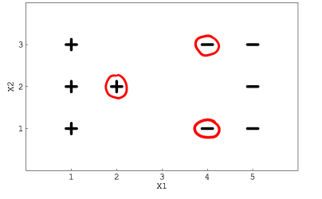
Spot Quiz
Suppose you are using a Linear SVM classifier with 2 classes. Now you have been given the following data in which the circled red are representing support vectors.
If you remove any red points from the data, does the decision boundary will change?
A) Yes
B) No
If you remove the non-red circled points from the data, the decision boundary will change?
A) True
B) False

Slide 3
Spot Quiz
Identifying fraudulent transactions to prevent financial loss.
Estimating the market value of properties based on features such as location, size, and amenities
Predicting the optimal price point for products or services based on demand, competition, and other factors
Diagnosing diseases from medical images with high accuracy and speed.
Predicting the remaining useful life of machinery or when it will likely require maintenance
Predicting the optimal price point for products or services based on demand, competition, and other factors

Slide 4
Python Training 1
The task is to predict if a bank currency note is authentic or not, based on four features:
skewness of the wavelet transformed image, variance of the image, entropy of the image, and curtosis of the image.
Use SVM and Logistic Regression algorithms to solve this problem.
Importing the Dataset
The data is available for download at the following link:
https://drive.google.com/file/d/13nw-uRXPY8XIZQxKRNZ3yYlho-CYm_Qt/view
The detailed information about the data is available at the following link:
https://archive.ics.uci.edu/ml/datasets/banknote+authentication

Slide 5
Python Training 1
Use the following code to import and split the dataset
Use SVM and Logistic Regression algorithms to solve this problem.
Print the accuracy score
import pandas as pd
import numpy as np
import matplotlib.pyplot as plt
%matplotlib inline
bankdata = pd.read_csv("bill_authentication.csv")
print(bankdata.shape)
print(bankdata.head())
X = bankdata.drop('Class', axis=1)
y = bankdata['Class']
from sklearn.model_selection import train_test_split
X_train, X_test, y_train, y_test = train_test_split(X, y, test_size = 0.25, random_state=42)

Slide 6
Python Training 2
Now Use the following code to import and split the breast_cancer detection dataset.
Use SVM and Logistic Regression algorithms to solve this problem.
Print the accuracy score
import numpy as np
import pandas as pd
import matplotlib.pyplot as plt
from sklearn.linear_model import Perceptron, LogisticRegression
from sklearn.svm import SVC
from sklearn.model_selection import train_test_split
from sklearn.preprocessing import StandardScaler
from sklearn import datasets
from sklearn import metrics
# Load the data set; In this example, the breast cancer dataset is loaded.
bc = datasets.load_breast_cancer()
X = bc.data
y = bc.target
print(bc.DESCR)
print(list(bc.feature_names))
print(list(bc.target_names))
X_train, X_test, y_train, y_test = train_test_split(X, y, test_size=0.25, random_state=42)

Slide 7
Outline
Classification Models:
Decision Trees
ENSEMBLE LEARNING
RANDOM FORESTS
Evaluating a Classification Model - Part One
Evaluation Metrics

Slide 8
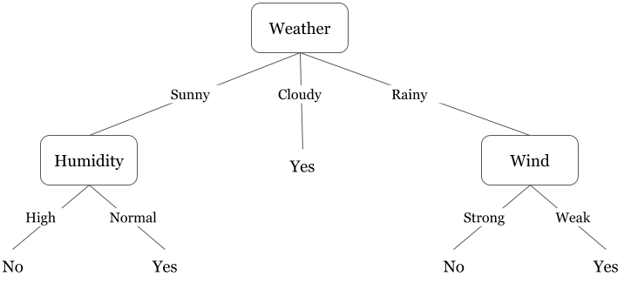
Decision Trees
Decision Trees can perform both classification and regression tasks.
They are powerful algorithms, capable of fitting complex datasets.
Decision Trees are also the fundamental components of Random Forests.
It uses a tree-like model of decisions.
Notice that the decisions are at “high-level” to keep the tree small.
It doesn’t include smaller level of “Humidity” or “Wind”.
The Decision Tree should be as small as possible
while aiming for high accuracy.
A decision tree of playing Badminton

Slide 9
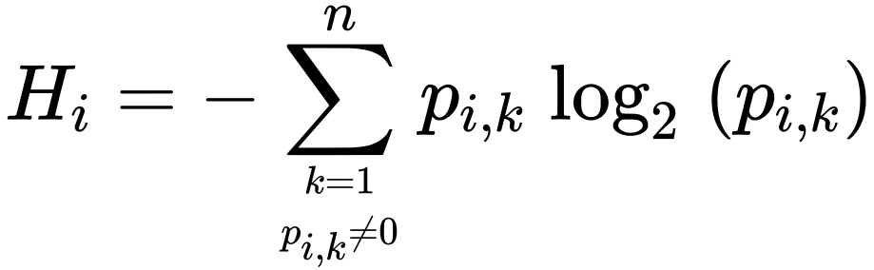
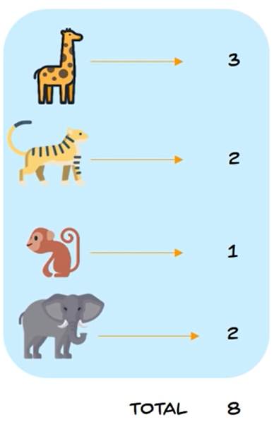
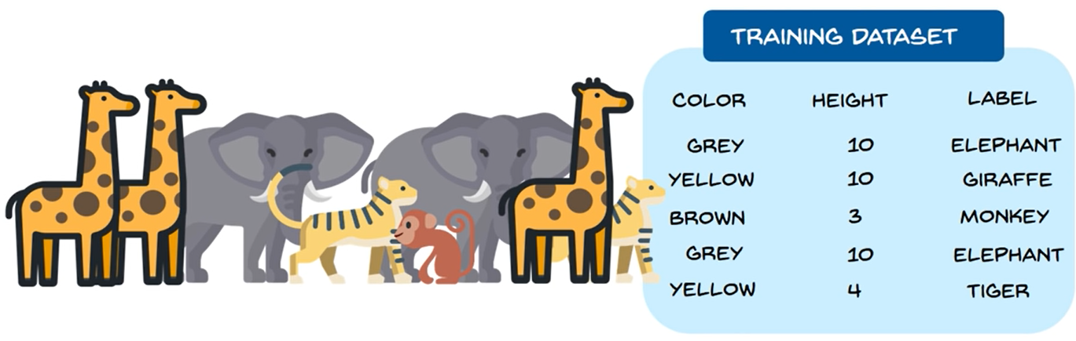
Decision Trees
Entropy: The measure of randomness or unpredictability of our dataset.
The higher the entropy, the harder it is to draw any conclusions from that information.
$P_{i,k}$ is the ratio of class $k$ instances among the training instances in the $i^{th}$ node.

Slide 10
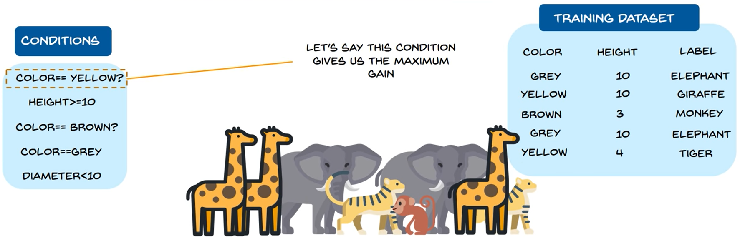
Decision Trees
We want to slip the data. But based on which feature (condition):
Color Yellow, Color Brown or Color Grey
Or Height or Diameter
The Decision Tree model evaluate the entropy for each condition and choose the lowest to do the first split.

Slide 11
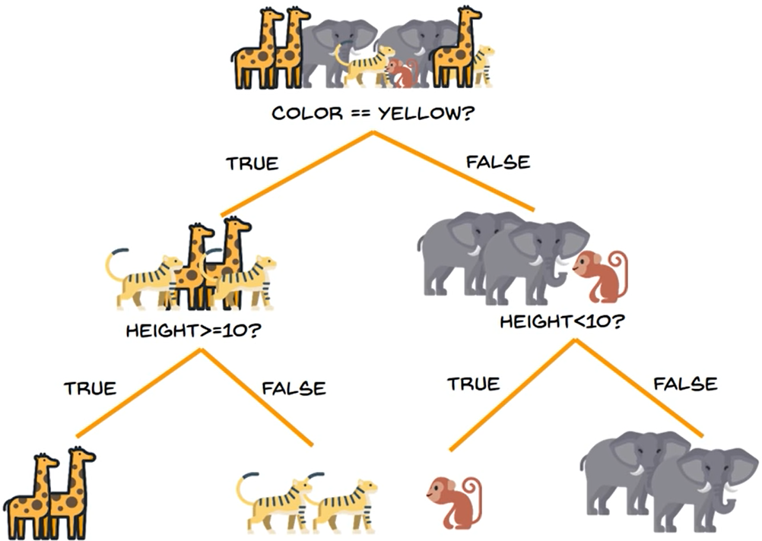
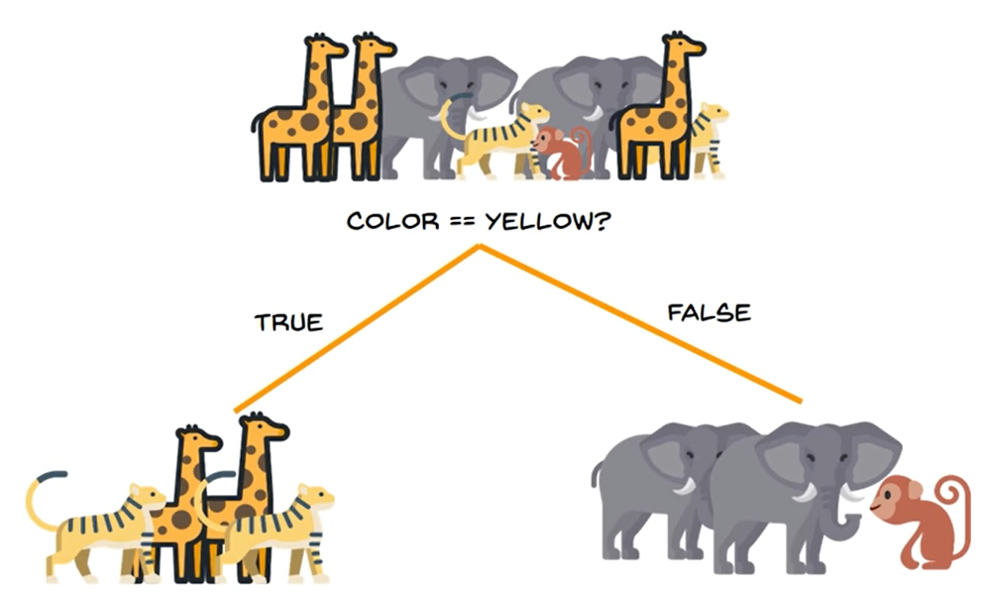
Decision Trees
After the first split the entropy deceases
Then the next should give an entropy closer to zero.

Slide 12
Decision Trees
Let’s Try Decision Trees in Python

Slide 13
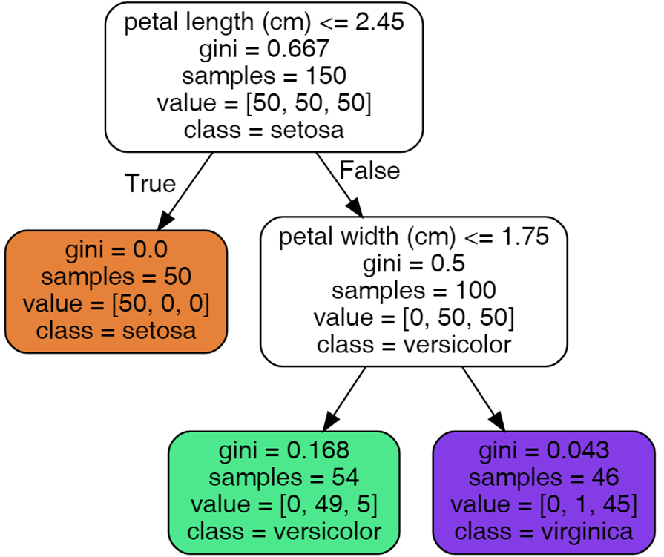
Decision Trees Training
To better understand Decision Trees, let’s build one.
Lets train a DecisionTreeClassifier on the iris dataset:
import numpy as np
import os
import matplotlib.pyplot as plt
from sklearn.datasets import load_iris
from sklearn.tree import DecisionTreeClassifier
iris = load_iris()
X = iris.data[:, 2:] # petal length and width
y = iris.target
tree_clf = DecisionTreeClassifier(max_depth=2, random_state=42)
tree_clf.fit(X, y)

Slide 14
Decision Trees Training
Let’s see how the tree makes predictions.
Suppose you find an iris flower and you want to classify it.
You start at the root node (depth 0, at the top):
Whether the flower’s petal length is Smaller than 2.45 cm.
True: move down to the root’s left child node (class=setosa).
False: move down to the root’s right child node.
Whether the flower’s petal length is Smaller than 1.75 cm.
True: move down to the root’s left child node (class= versicolor).
False: move down to the root’s right child node. (class= virginica).

Slide 15
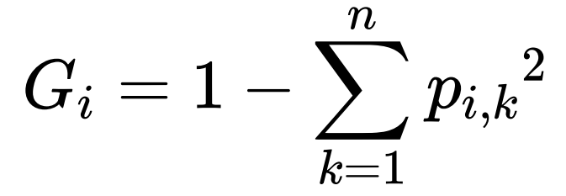
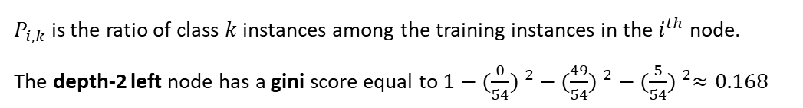
Decision Trees Predictions
A node’s samples attribute counts how many training instances it applies to.
For example, 100 training instances have a petal length greater than 2.45 cm (depth 1, right), and of those 100, 54 have a petal width smaller than 1.75 cm (depth 2, left).
A node’s value attribute tells you how many training instances of each class this node applies to: for example, the bottom right node applies to 0 Iris setosa, 1 Iris versicolor, and 45 Iris virginica.
Finally, a node’s gini attribute measures its impurity:
A node is “pure” (gini=0) if all training instances it applies to belong to the same class.
Following Equation shows how the training algorithm computes the gini score G of the i node.
$P_{i,k}$ is the ratio of class $k$ instances among the training instances in the $i^{th}$ node.
The depth-2 left node has a gini score equal to $1−{(\frac{0}{54}) }^{2}$ $−$ ${(\frac{49}{54}) }^{2}$ $−$ ${(\frac{5}{54}) }^{2}≈0.168$

Slide 16
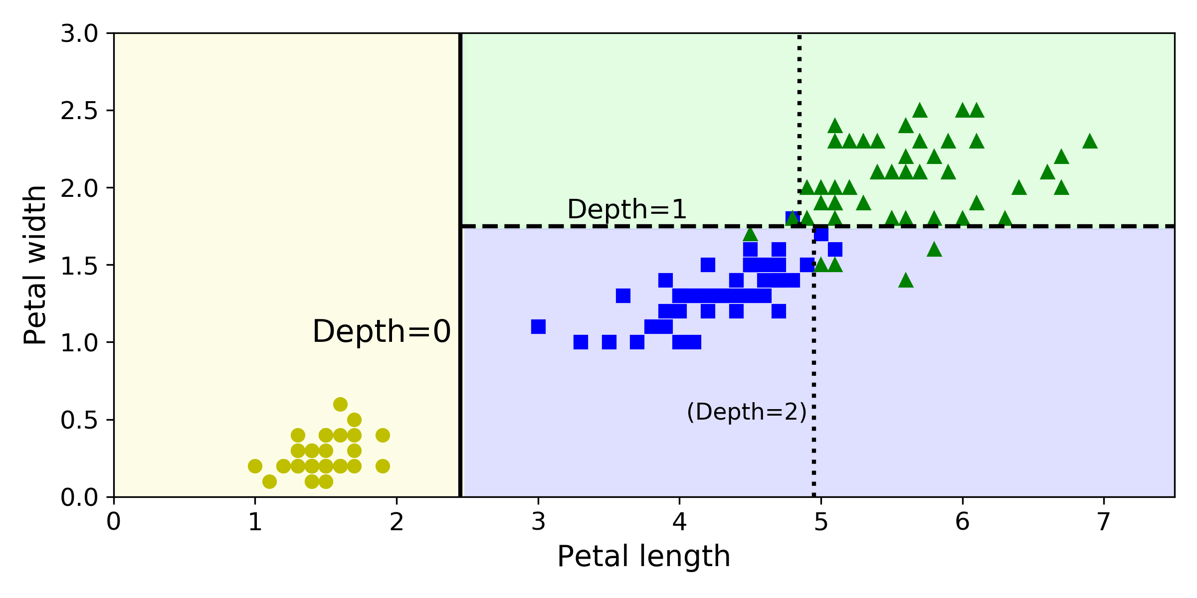
Decision Trees Decision Tree’s Decision Boundaries
The thick vertical line represents the decision boundary of the root node (depth 0): petal length = 2.45 cm.
The left hand area is pure so it cannot be split any further.
The right hand area is impure, so the depth-1 right node splits it at petal width = 1.75 cm (represented by the dashed line).
In the code we set the max_depth to 2, so the Decision Tree stops right there.
If we set max_depth to 3, then the two depth-2 nodes would each add another decision boundary (represented by the dotted lines).

Slide 17
Decision Trees Decision Tree’s Decision Boundaries
Code to the Figure:
from matplotlib.colors import ListedColormap
def plot_decision_boundary(clf, X, y, axes=[0, 7.5, 0, 3], iris=True, legend=False, plot_training=True):
x1s = np.linspace(axes[0], axes[1], 100)
x2s = np.linspace(axes[2], axes[3], 100)
x1, x2 = np.meshgrid(x1s, x2s)
X_new = np.c_[x1.ravel(), x2.ravel()]
y_pred = clf.predict(X_new).reshape(x1.shape)
custom_cmap = ListedColormap(['#fafab0','#9898ff','#a0faa0'])
plt.contourf(x1, x2, y_pred, alpha=0.3, cmap=custom_cmap)
if not iris:
custom_cmap2 = ListedColormap(['#7d7d58','#4c4c7f','#507d50'])
plt.contour(x1, x2, y_pred, cmap=custom_cmap2, alpha=0.8)
if plot_training:
plt.plot(X[:, 0][y==0], X[:, 1][y==0], "yo", label="Iris setosa")
plt.plot(X[:, 0][y==1], X[:, 1][y==1], "bs", label="Iris versicolor")
plt.plot(X[:, 0][y==2], X[:, 1][y==2], "g^", label="Iris virginica")
plt.axis(axes)
if iris:
plt.xlabel("Petal length", fontsize=14)
plt.ylabel("Petal width", fontsize=14)
else:
plt.xlabel(r"$x_1$", fontsize=18)
plt.ylabel(r"$x_2$", fontsize=18, rotation=0)
if legend:
plt.legend(loc="lower right", fontsize=14)
plt.figure(figsize=(8, 4))
plot_decision_boundary(tree_clf, X, y)
plt.plot([2.45, 2.45], [0, 3], "k-", linewidth=2)
plt.plot([2.45, 7.5], [1.75, 1.75], "k--", linewidth=2)
plt.plot([4.95, 4.95], [0, 1.75], "k:", linewidth=2)
plt.plot([4.85, 4.85], [1.75, 3], "k:", linewidth=2)
plt.text(1.40, 1.0, "Depth=0", fontsize=15)
plt.text(3.2, 1.80, "Depth=1", fontsize=13)
plt.text(4.05, 0.5, "(Depth=2)", fontsize=11)
plt.show()

Slide 18
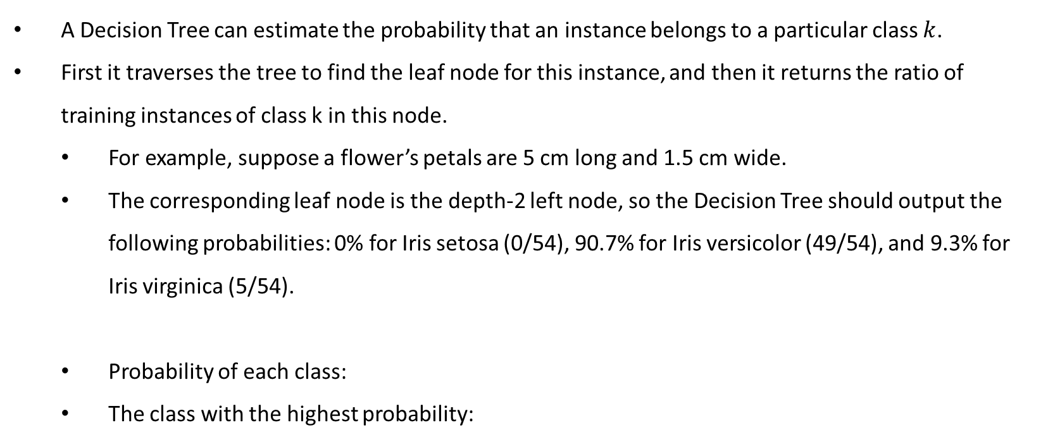
Decision Trees Class Probabilities
A Decision Tree can estimate the probability that an instance belongs to a particular class $k$.
First it traverses the tree to find the leaf node for this instance, and then it returns the ratio of training instances of class k in this node.
For example, suppose a flower’s petals are 5 cm long and 1.5 cm wide.
The corresponding leaf node is the depth-2 left node, so the Decision Tree should output the following probabilities: 0% for Iris setosa (0/54), 90.7% for Iris versicolor (49/54), and 9.3% for Iris virginica (5/54).
Probability of each class:
The class with the highest probability:
tree_clf.predict_proba([[5, 1.5]])
tree_clf.predict([[5, 1.5]])

Slide 19
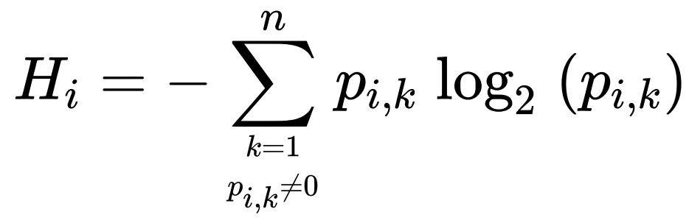
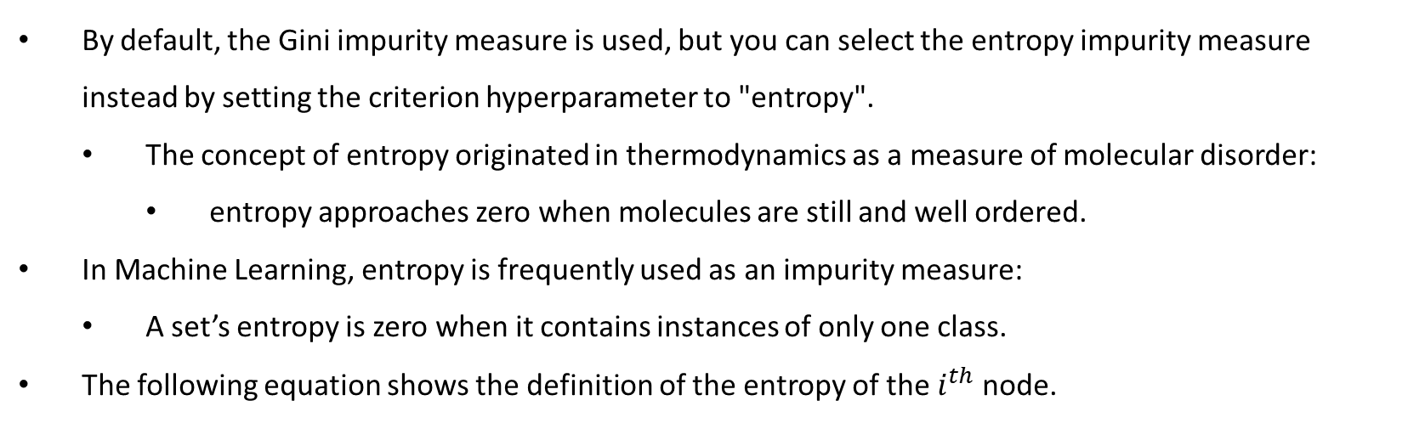
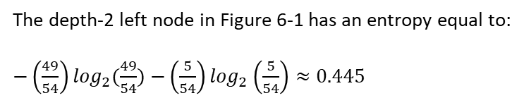
Decision Trees Entropy Impurity
By default, the Gini impurity measure is used, but you can select the entropy impurity measure instead by setting the criterion hyperparameter to "entropy".
The concept of entropy originated in thermodynamics as a measure of molecular disorder:
entropy approaches zero when molecules are still and well ordered.
In Machine Learning, entropy is frequently used as an impurity measure:
A set’s entropy is zero when it contains instances of only one class.
The following equation shows the definition of the entropy of the $i^{th}$ node.
The depth-2 left node in Figure 6-1 has an entropy equal to:
$−\left(\frac{49}{54}\right)\log_{2}(\frac{49}{54})$ $−\left(\frac{5}{54}\right)\log_{2}\left(\frac{5}{54}\right)≈0.445$

Slide 20
Decision Trees Hyperparameters
The DecisionTreeClassifier class has a few parameters that restrict the shape of the Decision Tree:
max_depth hyperparameter (restrict the maximum depth of the Decision Tree)
min_samples_split (the minimum number of samples a node must have before it can be split),
min_samples_leaf (the minimum number of samples a leaf node must have),
min_weight_fraction_leaf (same as min_samples_leaf but expressed as a fraction of the total number of weighted instances),
max_leaf_nodes (the maximum number of leaf nodes),
max_features (the maximum number of features that are evaluated for splitting at each node).

Slide 21
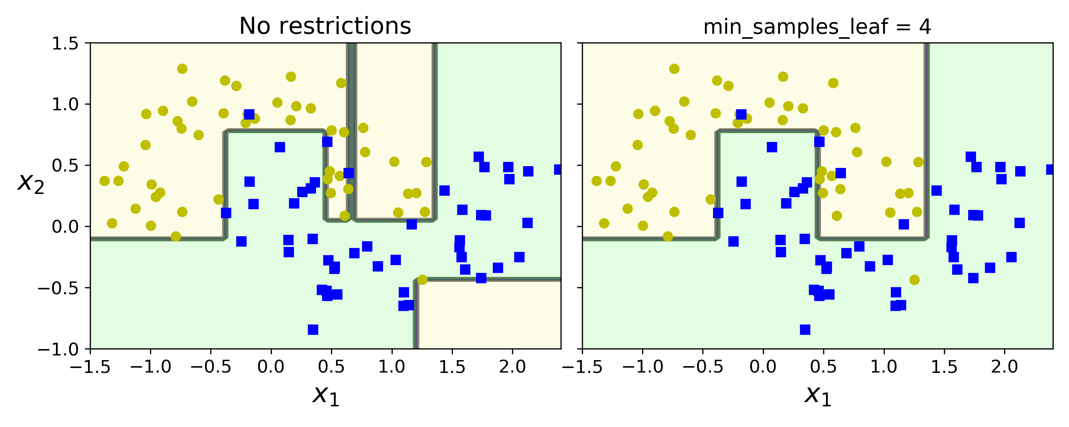
Decision Trees Hyperparameters
The Following code changes the min_samples_leaf :
from sklearn.datasets import make_moons
Xm, ym = make_moons(n_samples=100, noise=0.25, random_state=53)
deep_tree_clf1 = DecisionTreeClassifier(random_state=42)
deep_tree_clf2 = DecisionTreeClassifier(min_samples_leaf=4, random_state=42)
deep_tree_clf1.fit(Xm, ym)
deep_tree_clf2.fit(Xm, ym)
fig, axes = plt.subplots(ncols=2, figsize=(10, 4), sharey=True)
plt.sca(axes[0])
plot_decision_boundary(deep_tree_clf1, Xm, ym, axes=[-1.5, 2.4, -1, 1.5], iris=False)
plt.title("No restrictions", fontsize=16)
plt.sca(axes[1])
plot_decision_boundary(deep_tree_clf2, Xm, ym, axes=[-1.5, 2.4, -1, 1.5], iris=False)
plt.title("min_samples_leaf = {}".format(deep_tree_clf2.min_samples_leaf), fontsize=14)
plt.ylabel("")
plt.show()

Slide 22
Review Questions
Is a node’s Gini impurity generally lower or greater than its parent’s? Is it generally lower/greater, or always lower/greater?
If a Decision Tree is overfitting the training set, is it a good idea to try decreasing max_depth?
If it takes one hour to train a Decision Tree on a training set containing 1 million instances, roughly how much time will it take to train another Decision Tree on a training set containing 10 million instances?

Slide 23
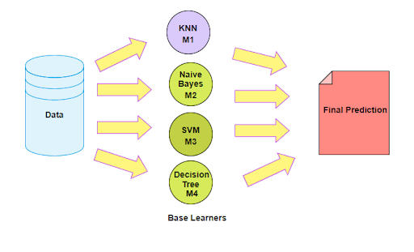
Ensemble Learning
Suppose you pose a complex question to thousands of random people, then aggregate their answers.
In many cases you will find that this aggregated answer is better than an expert’s answer. This is called the wisdom of the crowd.
Similarly, if you aggregate the predictions of a group of predictors (such as classifiers or regressors), you will often get better predictions than with the best individual predictor.
A group of predictors is called an ensemble; thus, this technique is called Ensemble Learning.

Slide 24
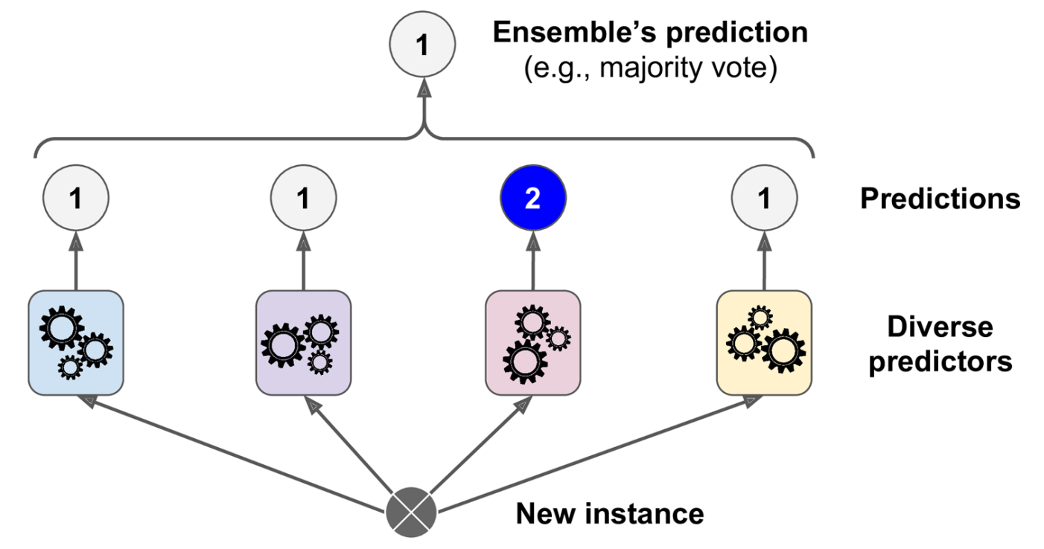
Ensemble Learning Voting Classifiers
There are two types of Voting Classifiers:
Hard: The class with highest votes gets chosen.
Soft: The class with the highest probability gets chosen.

Slide 25
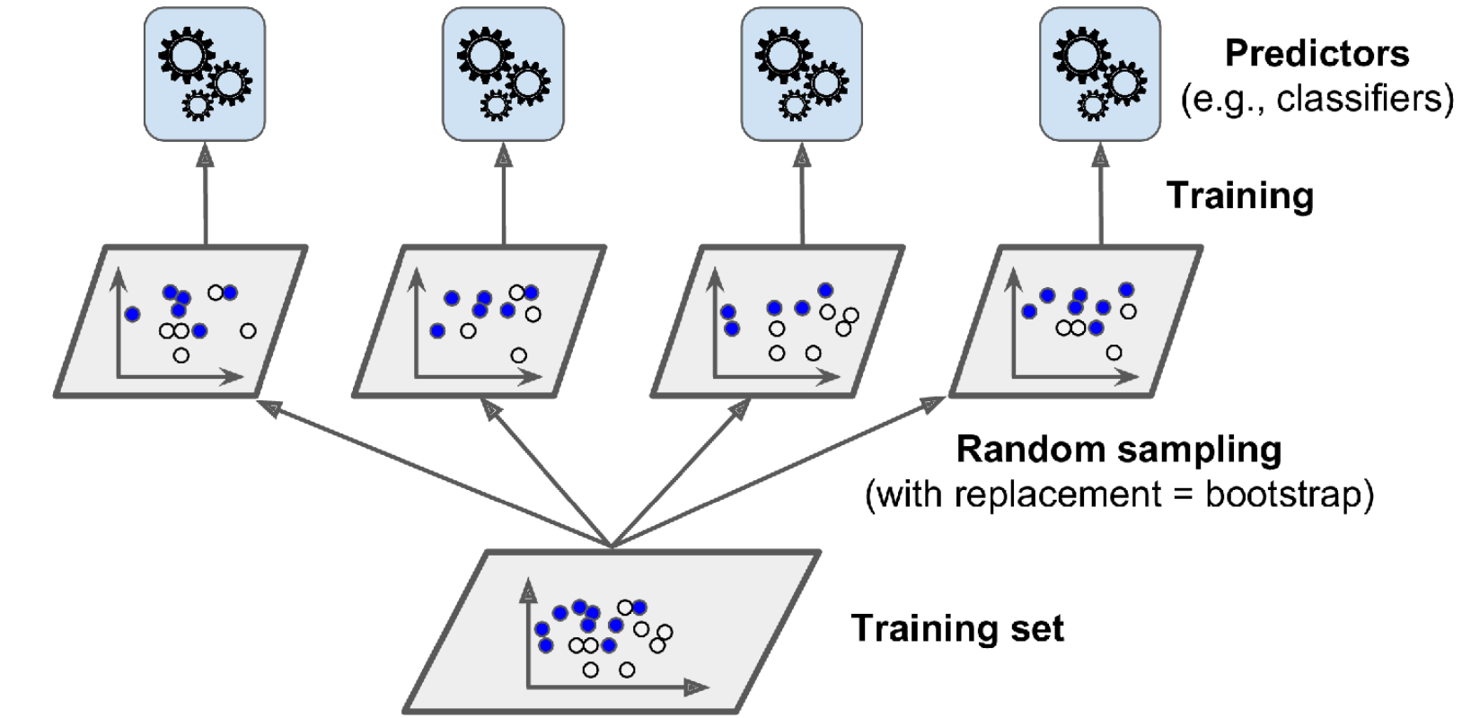
Ensemble Learning Bagging and Pasting
To use the same training algorithm for every predictor and train them on different random subsets of the training set.
Bagging: When sampling is performed with replacement.
Pasting: When sampling is performed without replacement.
Both bagging and pasting allow training instances to be sampled several times across multiple predictors, but only bagging allows training instances to be sampled several times for the same predictor.

Slide 26
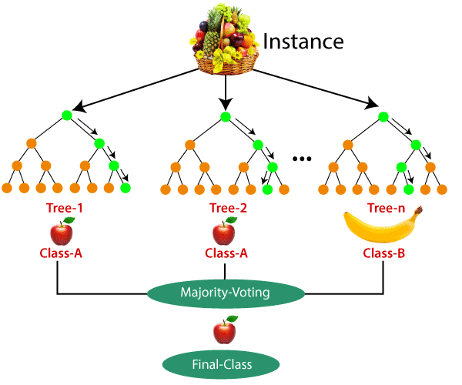
Random Forests
As an example of an Ensemble method, you can train a group of Decision Tree classifiers.
Each is trained on a different random subset of the training set.
To make predictions, you obtain the predictions of all the individual trees, then predict the class that gets the most votes
Random Forest is generally trained via the bagging method.
Random Forest is generally trained via training sets with the size of the original training set.

Slide 27
Random Forests with Sklearn
The following code uses all available CPU cores to train a Random Forest classifier with 500 trees (each limited to maximum 16 nodes):
from sklearn.model_selection import train_test_split
from sklearn.datasets import make_moons
X, y = make_moons(n_samples=500, noise=0.30, random_state=42)
X_train, X_test, y_train, y_test = train_test_split(X, y, random_state=42)
Prepare the data:
Training and Prediction:
from sklearn.ensemble import RandomForestClassifier
rnd_clf = RandomForestClassifier(n_estimators=500, max_leaf_nodes=16, random_state=42)
rnd_clf.fit(X_train, y_train)
y_pred_rf = rnd_clf.predict(X_test)

Slide 28
Random Forests with Sklearn Feature Importance
Random Forests make it easy to measure the relative importance of each feature.
Scikit-Learn measures a feature’s importance by looking at how much the tree nodes that use that feature reduce impurity on average (across all trees in the forest).
More precisely, it is a weighted average, where each node’s weight is equal to the number of training samples that are associated with it.
Scikit-Learn computes this score automatically for each feature after training, then it scales the results so that the sum of all importances is equal to 1.
We can access the result using the feature_importances_ variable.

Slide 29
Random Forests with Sklearn Feature Importance
The following code trains a RandomForestClassifier on the iris dataset and outputs each feature’s importance.
It seems that the most important features are the petal length (44%) and width (42%), while sepal length and width are rather unimportant in comparison (11% and 2%, respectively):
from sklearn.datasets import load_iris
iris = load_iris()
rnd_clf = RandomForestClassifier(n_estimators=500, random_state=42)
rnd_clf.fit(iris["data"], iris["target"])
for name, score in zip(iris["feature_names"], rnd_clf.feature_importances_):
print(name, score)
sepal length (cm) 0.112
sepal width (cm) 0.023
petal length (cm) 0.441
petal width (cm) 0.423

Slide 30
Review Questions
If you have trained five different models on the exact same training data, and they all achieve 95% precision, is there any chance that you can combine these models to get better results? If so, how? If not, why?
What is the difference between hard and soft voting classifiers?

Slide 31
Evaluating a Classification Model Pt.1
Steps in Machine learning pipeline:
By using different metrics for performance evaluation, we can improve the overall performance of our model before the production phase which works on unseen data.
Depending only on “accuracy”, can lead to a problem when the respective model is deployed on unseen data and can result in poor predictions.
Measuring the Performance of the Trained Model
Data Preparation
Training the Machine Learning Model
Optimising and Regularising the Model
Final Training

Slide 32
Evaluating a Classification Model Pt.1 Evaluation Metrics
There are different metrics for the tasks of classification, regression, ranking, clustering, etc.
Some metrics are useful for multiple tasks, some for only certain tasks.
Metrics and Methods we will study today:
Model Accuracy
Confusion Matrix
Precision and Recall
F1 Score

Slide 33


Evaluating a Classification Model Pt.1 Evaluation Metrics Model Accuracy
Model accuracy in terms of classification models can be defined as the ratio of correctly classified samples to the total number of samples:
For Binary classification:
(It is the same equation shown in a different way)
Let say there are 2 classes: Positive COVID-19 and Negative COVID-19
True Positive (TP) — A true positive is an outcome where the model correctly predicts the positive class.
True Negative (TN) —A true negative is an outcome where the model correctly predicts the negative class.
False Positive (FP) —A false positive is an outcome where the model incorrectly predicts the positive class.
False Negative (FN) —A false negative is an outcome where the model incorrectly predicts the negative class.
$$Accuracy=\frac{Number of correct predidtions}{Total number of prediction}$$
$$Accuracy=\frac{TP+TN}{TP+TN+FP+FN}$$

Slide 34

Evaluating a Classification Model Pt.1 Evaluation Metrics Confusion Matrix
Confusion Matrix for binary classifications:
Let’s present an example:
Binary Classification Model: Predict whether the patient has COVID-19 or No COVID-19.
Let’s assume we have a training dataset with labels:
100 cases, 10 labelled as ‘COVID-19’, 90 labelled as ‘No COVID-19’
Let’s try calculating the accuracy of a model given which gives the following results:
 | Predicted
Actual |  | Positive | Negative
 | Positive | TP | FN
 | Negative | FP | TN
$$Accuracy=\frac{4+89}{4+89+1+6}=\frac{93}{100}$$
TP (Actual COVID-19 and predicted COVID-19) = 4
TN (Actual No COVID-19 and predicted No COVID-19) = 89
FN (Actual COVID-19 and predicted No COVID-19) = 6
FP (Actual No COVID-19 and predicted COVID-19) = 1
 | Predicted
Actual |  | COVID-19 | No COVID-19
 | COVID-19 | 4 | 6
 | No COVID-19 | 1 | 89

Slide 35




Evaluating a Classification Model Pt.1 Evaluation Metrics Precision and Recall
The precision for a class is the number of true positives divided by the total number of elements labelled as belonging to the positive class (the sum of true positives and false positives):
Recall is defined as the number of true positives divided by the total number of elements that actually belong to the positive class (the sum of true positives and false negatives):
In Our Example:
$$Precision=\frac{TP}{TP+FP}$$
$$Recall=\frac{TP}{TP+FN}$$
Our model has a precision value of 0.8.
When it predicts COVID-19, it’s correct 80% of the time.
Our model has a recall value of 0.4.
It correctly identifies only 40% of all COVID-19 patients.
$$Precision=\frac{4}{4+1}=0.8$$
$$Recall=\frac{4}{4+6}=0.4$$

Slide 36


Evaluating a Classification Model Pt.1 Evaluation Metrics F1 Score
It is defined as the harmonic mean of the model’s precision and recall.
Why Harmonic mean and not simple average?
Harmonic mean is not sensitive to extremely large values, unlike simple averages.
Let say, we have a model with a precision of 1, and recall of 0 gives a simple average as 0.5 and an F1 score of 0.
If one of the parameters is low, the second one no longer matters in the F1 score.
The F1 score favours classifiers that have similar precision and recall.
The F1 score is a better measure to use if you are seeking a balance between Precision and Recall.
$$F1 Score=2∗\frac{Precision∗Recall}{Precision+Recall}$$
$$F1 Score in our example=2∗\frac{0.8∗0.4}{0.8+0.4}≈0.53$$

Slide 37
Evaluating a Classification Model Pt.1 Evaluation Metrics Python Codes
Confusion Matrix:
Accuracy:
Classification report that includes
Precision, Recall and F1-Score for each class:
“y_pred” is the prediction of the model
from sklearn import metrics
metrics.confusion_matrix(y_test, y_pred)
from sklearn import metrics
metrics.accuracy_score(y_test, y_pred)
from sklearn import metrics
metrics.classification_report(y_test, y_pred)

Slide 38
Any Questions?

